Slide 1
Data visualization
Stefan Hartmann
HHU Düsseldorf

Slide 2
Plan for today
Introduction
Basics of data visualization
Data wrangling in R
Basics of ggplot2
A first example graph
Case studies and hands-on exercises
Some (fairly random but perhaps useful) tips and tricks

Slide 3
Introduction

Slide 4

Introduction
Who am I? Who are you?
Notes:
What are you expecting from this class? What's your experience in R? If you don't know R, do you know other programming languages?

Slide 5


Preliminaries
Software
programming language
Integrated Developing Environment

Slide 6


Preliminaries
Posit Cloud and GitHub repository
Posit Cloud: basically an online version of RStudio, no desktop installation required
https://posit.cloud
Link to repository for our workshop:
https://t1p.de/DatVizLava
Github repository: https://github.com/hartmast/DatVizLava

Slide 7
Basics of R and RStudio
R: https://cran.r-project.org/
RStudio: https://posit.co/download/rstudio-desktop/

Slide 8
Basics of R
Things to know about R
R is, first and foremost, a programming language
RStudio is an Integrated Developer Environment (IDE) that provides a user-friendly "window" to R
There are two "dialects" of R:
base R,
the "tidyverse" syntax

Slide 9
Principles of data visualization

Slide 10
Data visualization
Why visualize?
For yourself
Exploring your data
detecting outliers
checking assumptions of statistical tests or models (e.g. are the data normally distributed?)
etc.
For others
Showing your findings in a clear and efficient way
Graphs tend to be more reader-friendly than tables...
and much more reader-friendly than long inline lists!

Slide 11

Data visualization
Why R?
de-facto standard in linguistics (currently)
versatile visualization options
also, this doesn't happen:

Slide 12
Data visualization
Choosing the "right" plot
What kind of data are you dealing with?
What is your research question?

Slide 13
Types of data
Levels of measurement
categorical variables:
nominal variable: e.g. married, not married, divorced; Swiss, German, French...
Subtype: binary variable, e.g. living/dead
ordinal variable: e.g. gold medal, silver medal, bronze medal
metric variables:
interval variable: e.g. temperature (Celsius, Fahreneit)
ratio variable: e.g. weight, temperature (Kelvin)
(absolute / count variable: natural unit, e.g. number of students, age)

Slide 14
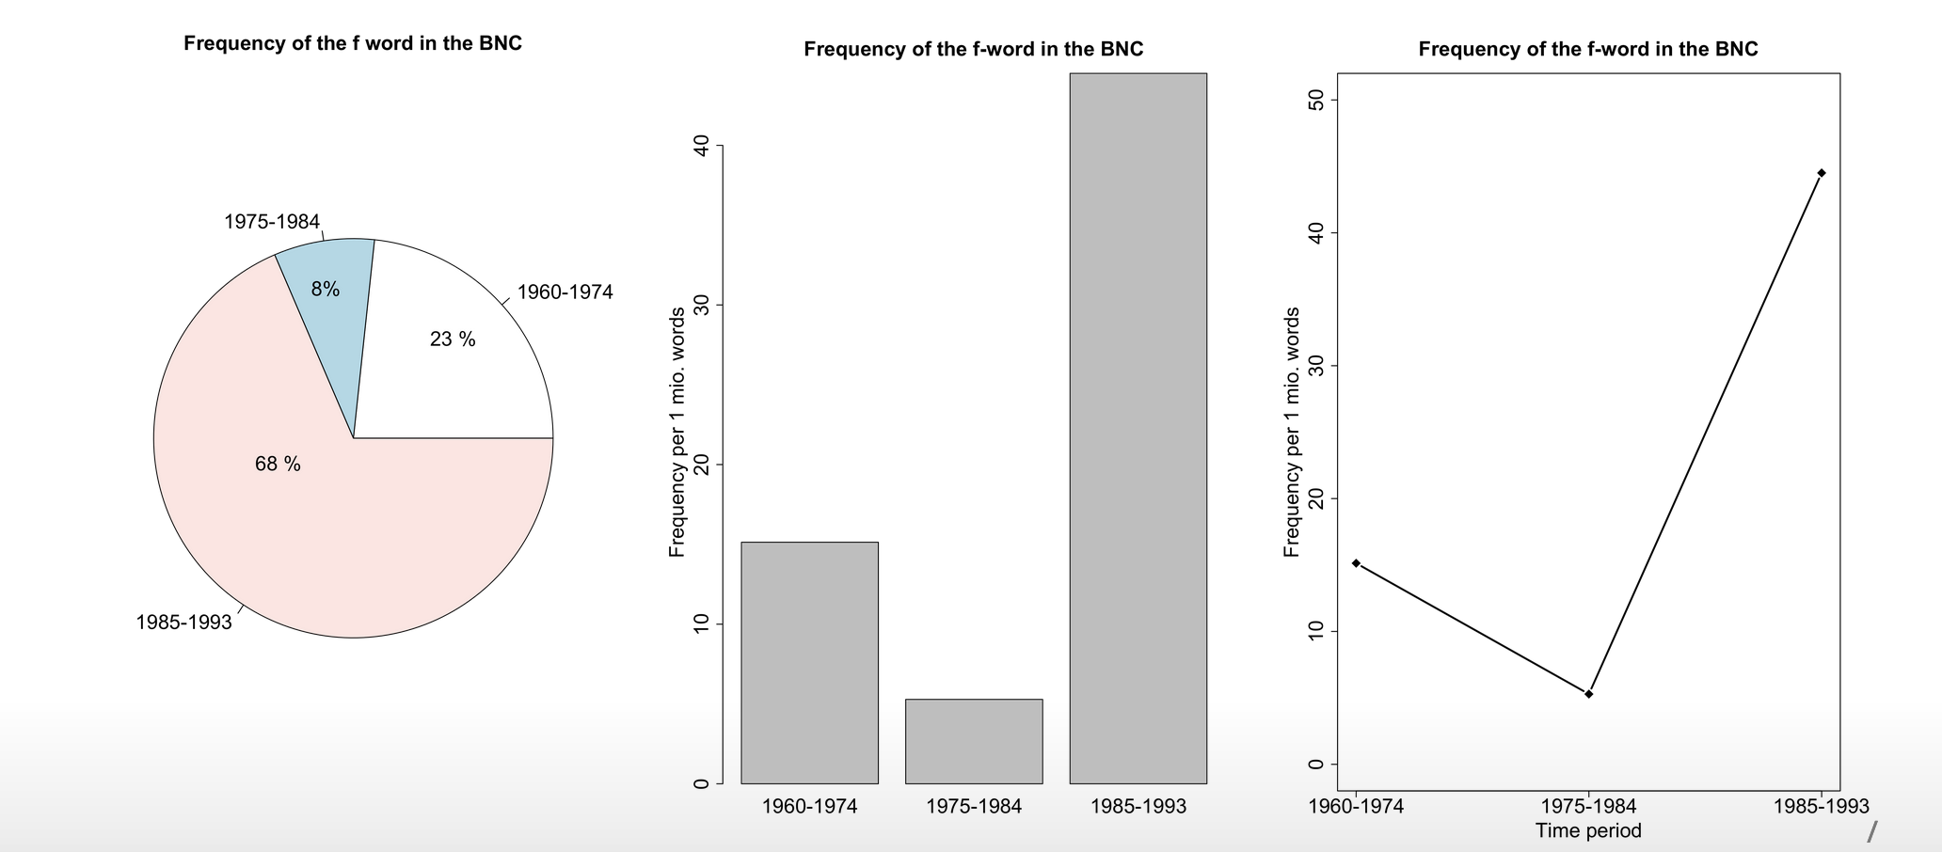
Data visualization

Slide 15
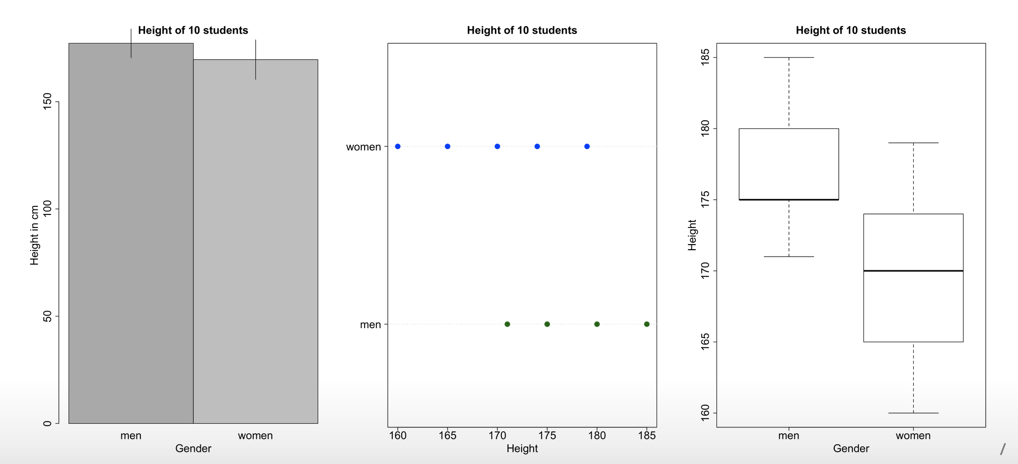
Data visualization

Slide 16
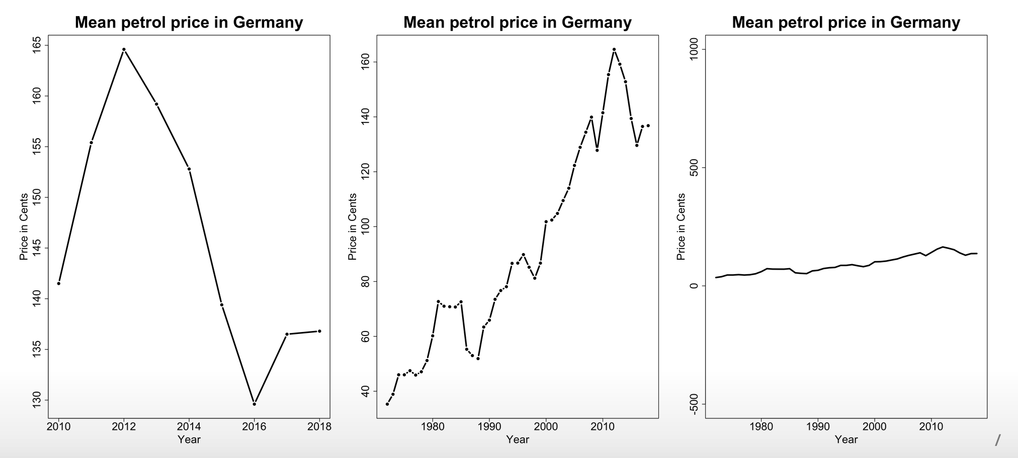
Data visualization

Slide 17
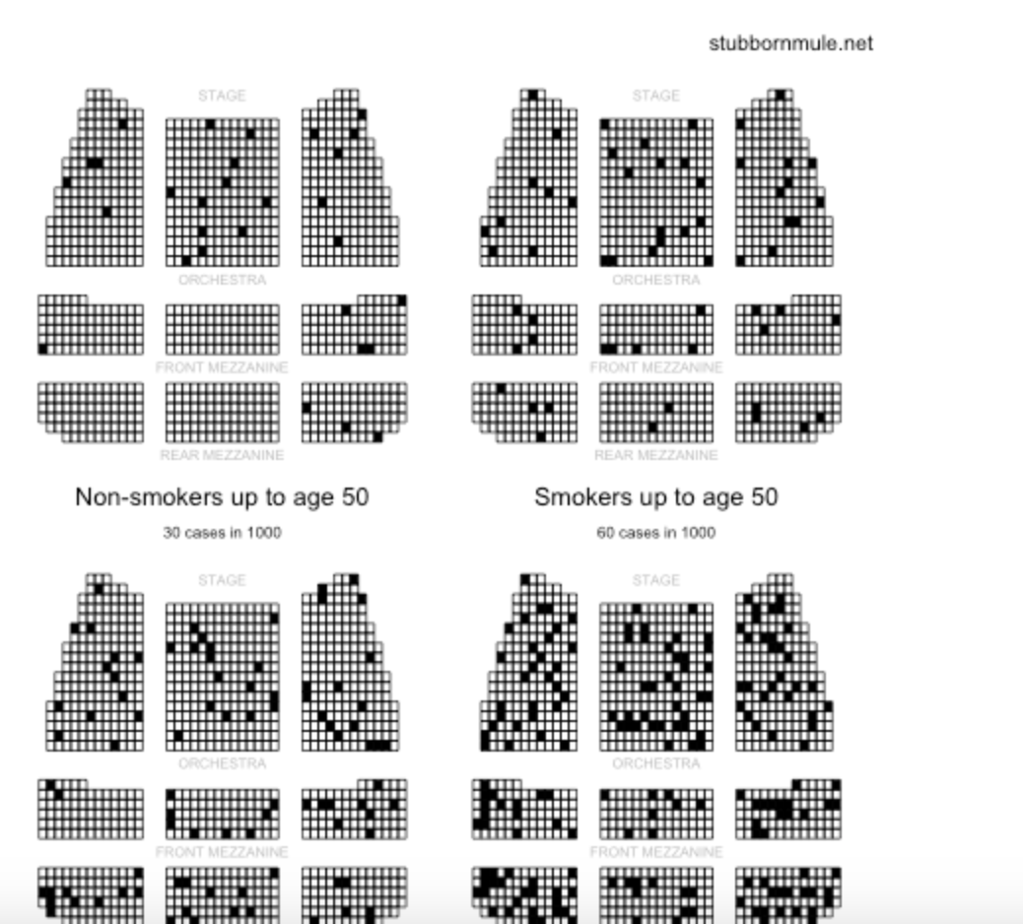
Alternative visualizations
from http://www.stubbornmule.net/2010/10/visualizing-smoking-risk/
"Risk Characterization Theatre" from Rifkin & Bouwer (2007)

Slide 18
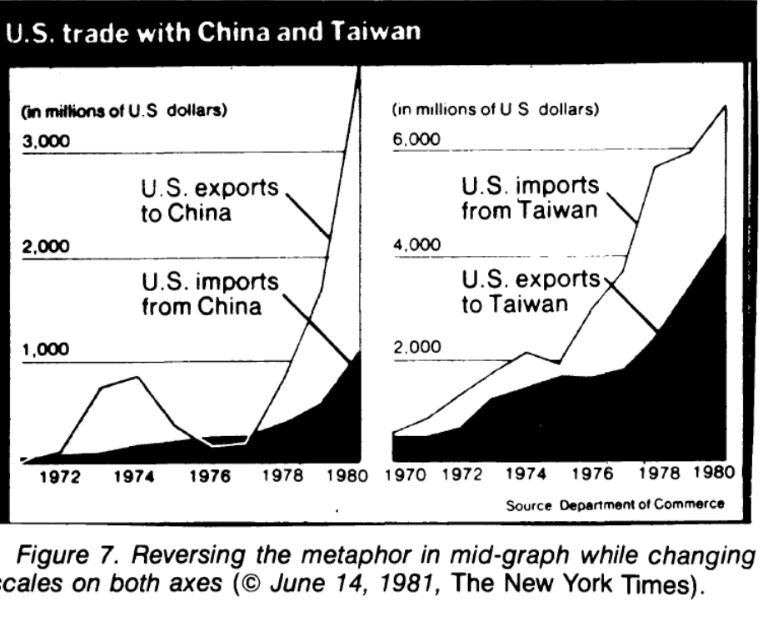
The plot as a metaphor
"The essence of a graphic display is that a set of numbers having both magnitudes and an order are represented by an appropriate visual metaphor - the magnitude and order of the metaphorical representation match the numbers." (Wainer 1984: 139)

Slide 19
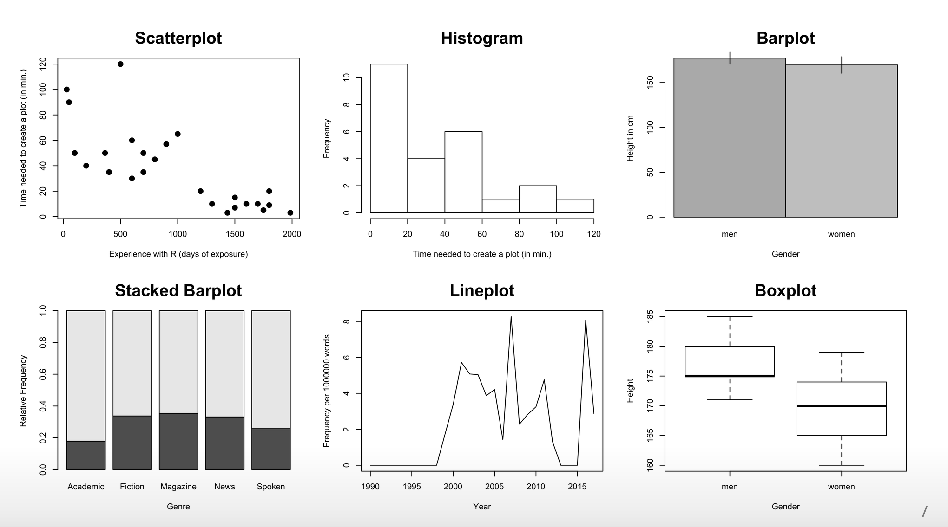
Plot types

Slide 20
Best practice for reporting & displaying data
Most importantly: Know your data!
When reporting percentages, also report the denominator (i.e. the size of your sample)
Example: "50% of academics are alcoholics" - it makes a difference whether your sample size is 2 or 2,000.
When reporting comparisons of absolute frequencies, double-check if your samples are comparable.
Example: "255 women agree that cats are adorable, but only 5 men." - it makes a difference whether your sample consists of 300 women and 300 men or of 300 women and 10 men.
When reporting means, also report standard deviations.

Slide 21
Best practices
Show the data
Avoid distorting the data
Keep "Ink-to-data ratio" as low as possible
Use meaningful x and y labels
Avoid overplotting (e.g. 3-dimensional plots when only 2 dimensions are displayed)

Slide 22
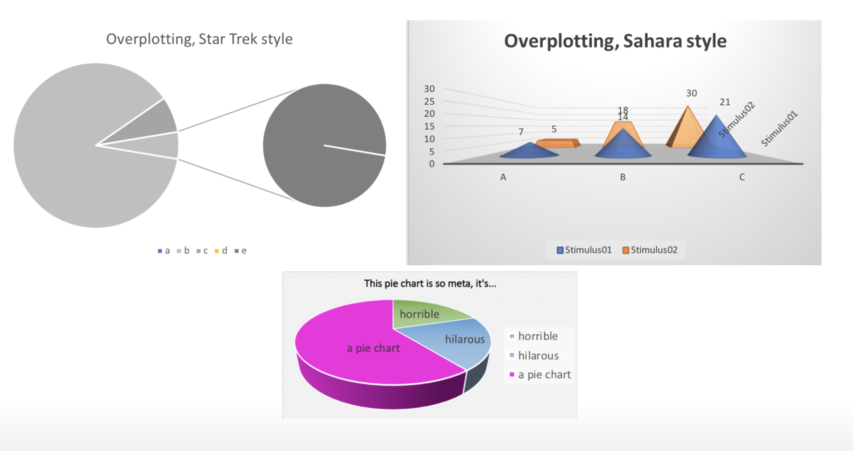
Beware of overplotting

Slide 23
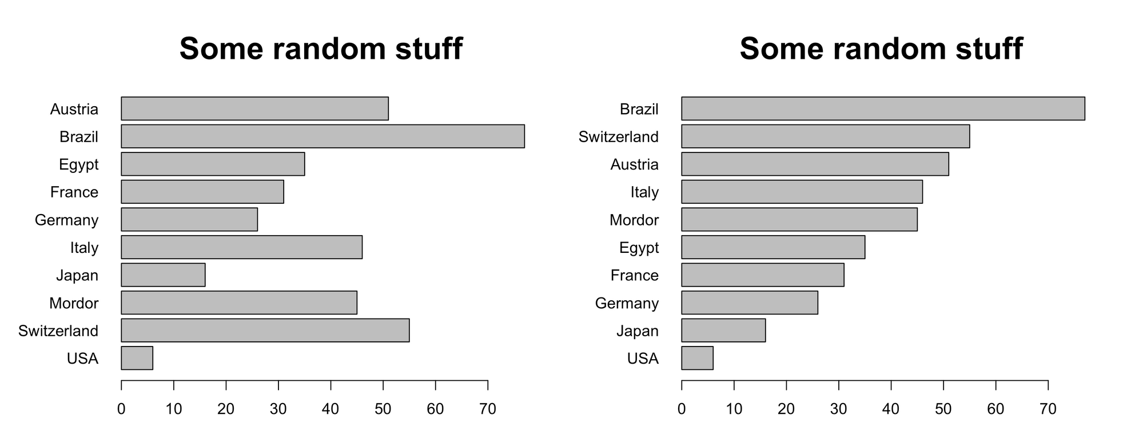
Further tips
If there is no natural order to your data, order them by value

Slide 24
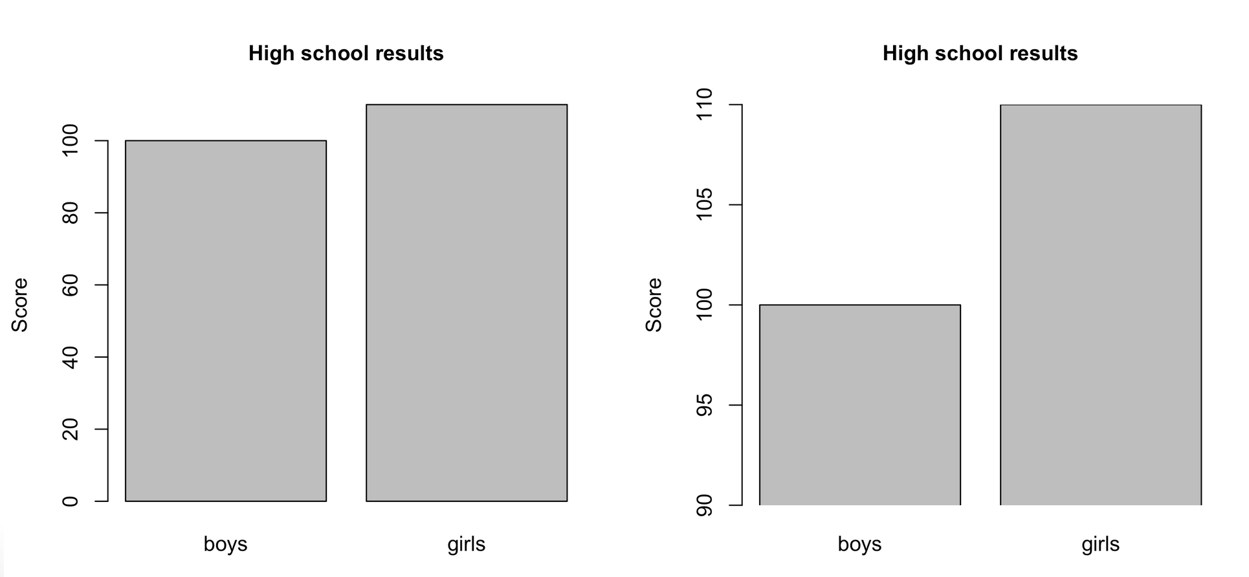
Further tips
Don't cut the y axis unless there are good conceptual reasons to do so.

Slide 25
Basics of R

Slide 26
Basics of R
Things to know about R
R is, first and foremost, a programming language
RStudio is an Integrated Developer Environment (IDE) that provides a user-friendly "window" to R
There are two "dialects" of R:
base R,
the "tidyverse" syntax

Slide 27
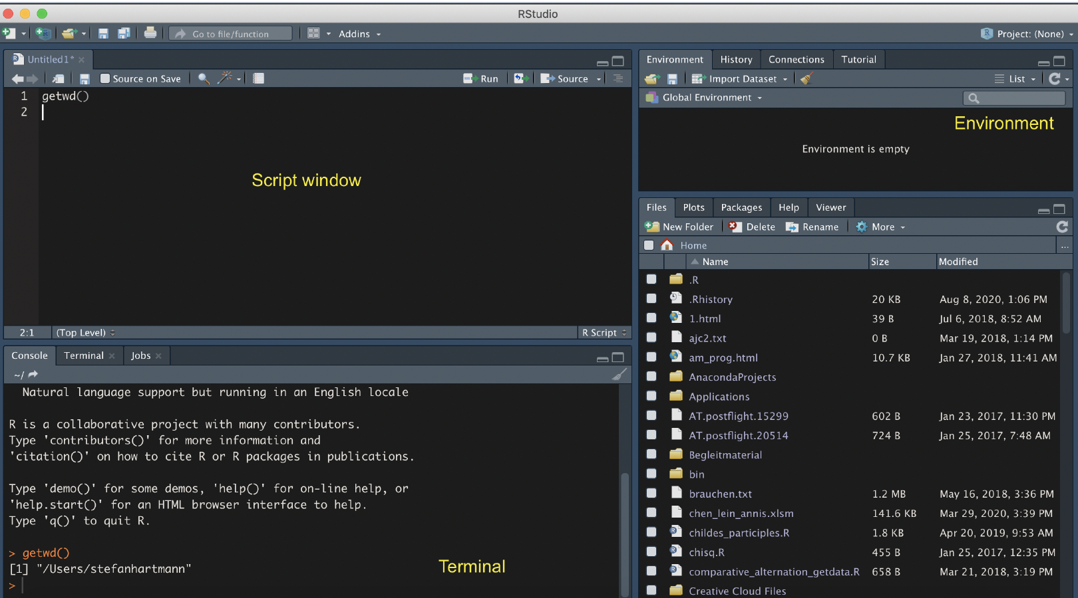
The RStudio Interface

Slide 28
First steps in R
R as a calculator
Please try:
2 + 2
sqrt(25)
5*6

Slide 29
Getting data into R
Important preliminaries
Ground rule: R is "stupid".
Unlike Google or ChatGPT, R doesn't try to correct our errors.
Among other things, this means that...
it is case sensitive
in some contexts, it makes a difference if you use scarequotes or not
When it has assigned a data type to an object, it will stick to it: if it thinks that "26" is a set of strings (characters) and not a number, then it won't do any calculations with it, unless you coerce it to treat it as a number using a command like as.numeric().
See https://www.burns-stat.com/documents/books/the-r-inferno/ for entertaining examples of R users' common errors.

Slide 30
Data wrangling in R

Slide 31
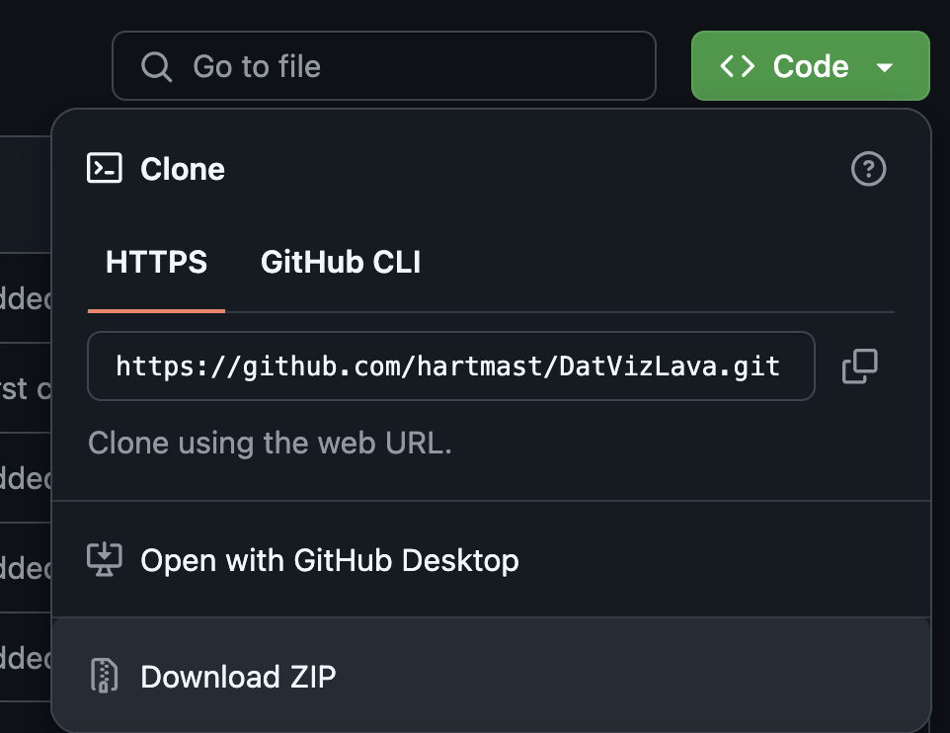
Data
Data available at
https://github.com/hartmast/DatVizLava
or in the Posit Cloud:
https://t1p.de/DatVizLava
1
2
3
unzip folder
Notes:
Some files are rather big, so you might have to increase post buffer size first:
git config --global http.postBuffer 157286400

Slide 32
Types of data
Types of data in R
character: "a", "swc"
double: 2, 15.5
integer: 2L (the L tells R R to store this as an integer)
logical: TRUE, FALSE
complex: 1+4i (complex numbers with real and imaginary parts)
Notes:
Imagenary numbers: e.g. for square roots of negative numbers: Square roots of negative real numbers do not exist in the real numbers. They do exist in the complex numbers, using the imaginary unit 𝑖. For our purposes, we don't have to bother with imaginary numbers.
An integer can only take whole number values and requires an L to be added after the number to tell R you want the number stored as an integer.
Double-precision floating-point format (sometimes called FP64 or float64) is a floating-point number format, usually occupying 64 bits in computer memory;
Single-precision floating-point format (sometimes called FP32 or float32) is a computer number format, usually occupying 32 bits in computer memory; it represents a wide dynamic range of numeric values by using a floating radix point. Not supported by base R, but known to users of other programming languages under the name "float".

Slide 33
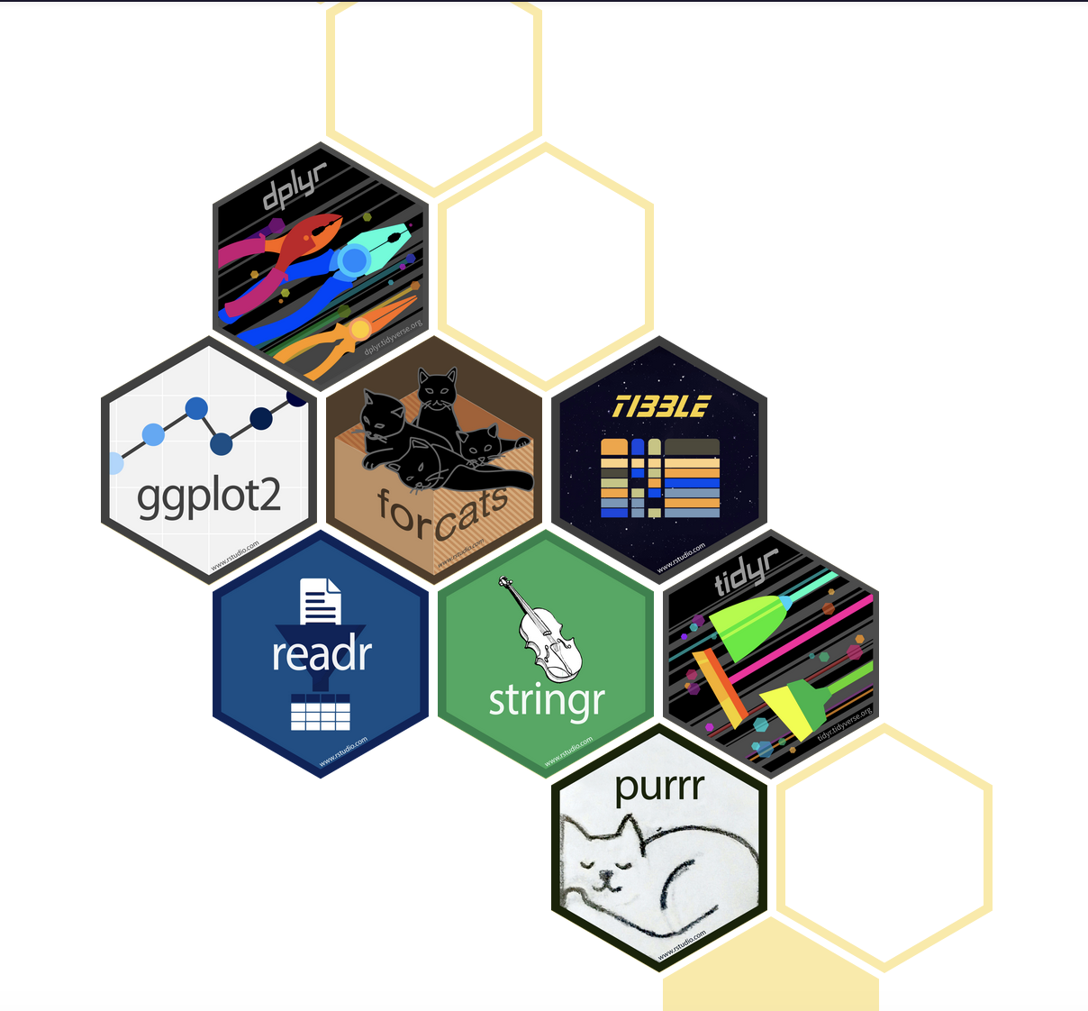
Base R and Tidyverse
What is the Tidyverse?
family of packages developed by RStudio/Posit
implement an own "dialect" of R
still fully compatible with base R, but adding more syntax possibilities

Slide 34
Base R and Tidyverse
Pros and cons of the Tidyverse
Pro:
syntax is arguably more intuitive and cleaner once you get used to it (especially "piping"!)
offers really neet functions for data wrangling
ggplot2 offers great possibilities for visualization
it is very widely used and many replies in forums rely on it
Cons:
it is under very active development, some functions become deprecated or change their names → problems for reproducibility
can be a bit patronizing (although this can sometimes be a good thing)
some things are ridiculously counterintuitive

Slide 35
Data wrangling and preprocessing
Steps
Structuring
Cleaning
Validating
Handling missing data (→ imputation)
Merging data from different sources
Transforming variables (can also be seen as already part of the statictical analysis*)
*In fact, all these steps are, strictly speaking, part of the analysis!
Notes:
imputation: replacement values for missing data
Transforming variables kind of already is part of the statistical analysis, though

Slide 36
Dealing with dataframes
Reading in dataframes
Commands for reading in spreadsheets:
CSV: readr::read_csv()
TSV etc.: readr::read_delim(delim="\t", ...)
Excel: readxl::read_xlsx()
plain text: readr::read_lines()
large files: vroom::vroom or datatable::data.table()
the stuff before :: refers to the packages to which these functions belong and can be omitted if you have loaded the packages via library() or require(). readr() is part of the tidyverse and is automatically loaded when you run library(tidyverse)

Slide 37
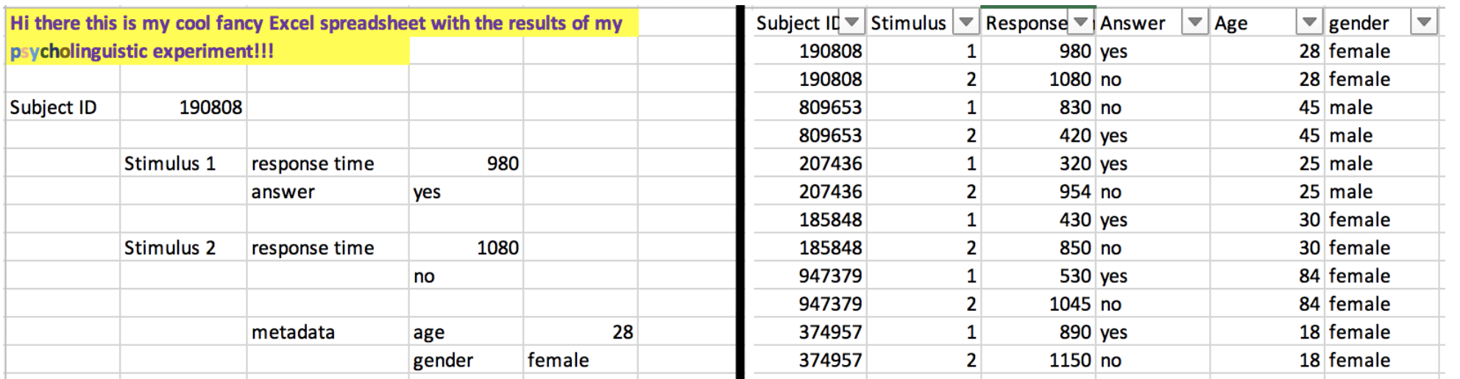
Data wrangling
"Tidy data"
Use "tidy data": One variable per column
One observation per row

Slide 38
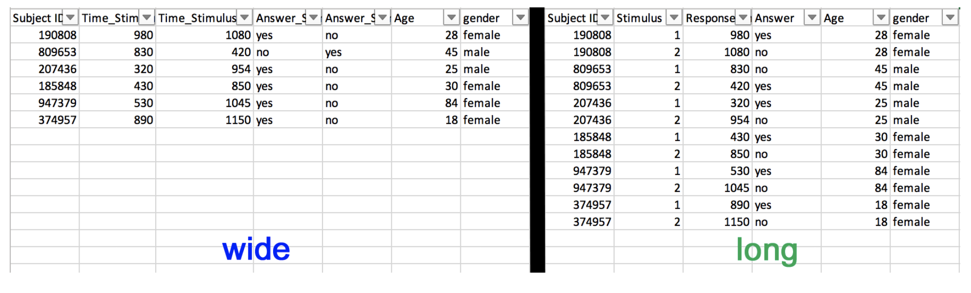
"Long" vs. "wide" format

Slide 39
"Long" vs. "wide" format
From long to wide format
If necessary, data can be converted from "long" to "wide" format using the pivot_wider() and pivot_longer() functions from the tidyverse family of packages.
(They may not be 100% intuitive but with a bit of trail and error they work really well!)

Slide 40
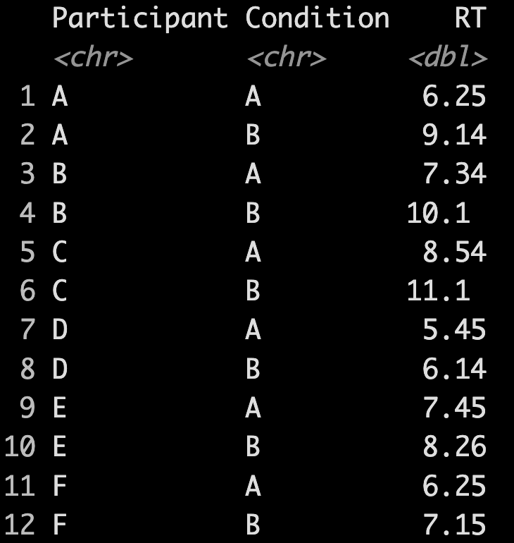
"Long" vs. "wide" format
Hands-on example...
Read the dataset fake_RT_data.xlsx using readxl::read_xlsx
Use the pivot_longer() command to transform the dataset in a longer format:

Slide 41
Dealing with dataframes
Merging multiple dataframes
In many cases we want to combine dataframes, e.g. because one dataframe contains metadata pertaining to the other dataframe
Example: We have one file with corpus data, with one column specifying the author, and one file with birth and death dates of each author crawled from the German National Library and/or Wikipedia
We can combine the dataframes using dplyr's join() commands.

Slide 42
Dealing with dataframes
Hands-on task
...

Slide 43
Basics of ggplot

Slide 44

ggplot
The syntax of ggplot
A ggplot consists of three components
the data,
a set of aesthetic mappings,
at least one layer (usually created with the geom function) describing how to render each observation.

Slide 45
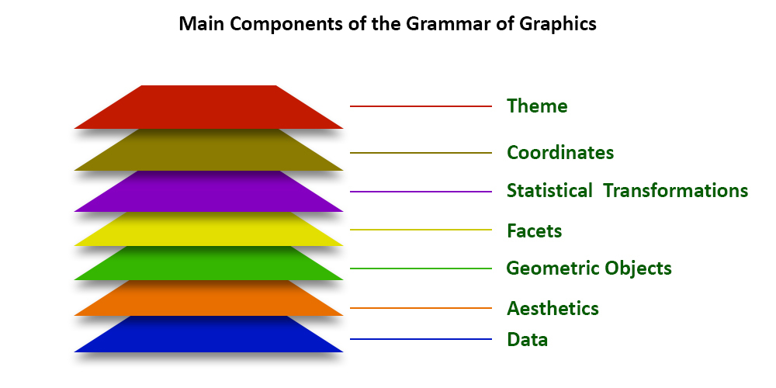

Slide 46
ggplot
Creating a ggplot
A ggplot is built layer by layer
We start out with the data and the aesthetic mappings
Basic syntax:
p <- ggplot(data, aes(x = ..., y = ..., group = ...))
We specify the geometric objects to plot, e.g.
p <- p + geom_line() # lineplot
Optional: We customize the scales (position, color, size) and/or change the theme of the plot
p <- p + scale_color_grey() + theme_minimal()

Slide 47
ggplot
A basic ggplot
First step: generating fake data
Try to create a dataframe with two columns x and y, with x containing the numbers from 1 to 100 and y 100 normally-distributed random numbers (rnorm(100)).
Second step: visualizing the data
Plot x against y using base R first and then using ggplot.
Third step: customizing the plot
Play around with different scale configurations and themes.

Slide 48
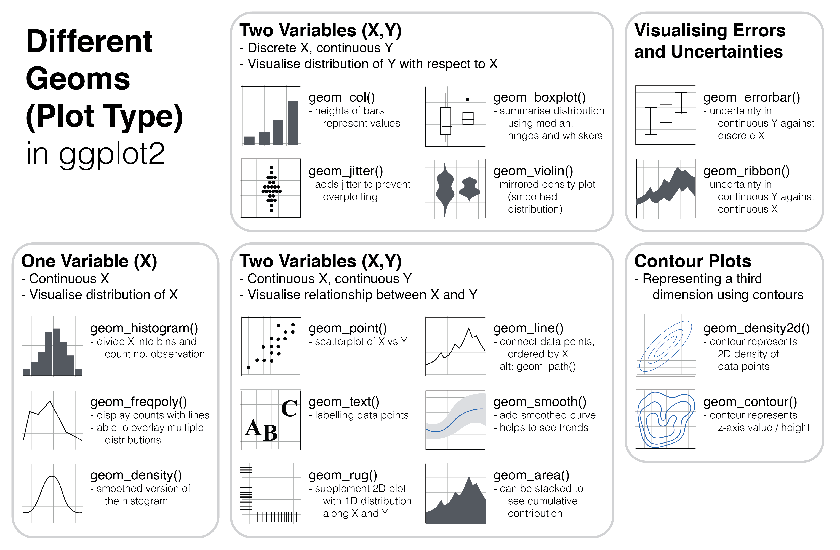
What kinds of geoms exist?

Slide 49
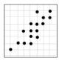
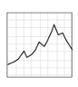
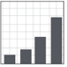
Plot types
Which plot types for which purpose?
Scatterplots
show / explore correlations between two variables
metric data on both the x- and the y-axis
Line plots
Lineplots are useful for showing e.g. change over time
Count variable on y-axis, (at least) ordinal variable on x-axis
Barplots
useful to show counts of categorical variables (e.g. number of men vs. number of women in parliament)...
summary statistics (usually: means) of metric variables across different categories (e.g. mean height of humans vs. Klingons)

Slide 50
More plot types
Beeswarm plots
Packages beeswarm and ggbeeswarm
can be combined with violin or boxplots

Slide 51
Interactive plots
e.g. (gg)plotly packge
and shinyplots (shinyplots.io)

Slide 52
Some tips and tricks
Cheat sheets
Code snippets
https://r-graph-gallery.com/
Google/Stackoverflow is your friend ☺

Slide 53
Hands-on example...

Slide 54
Hands-On Task
-ish in the BNC
Load the dataset BNC_ish.csv.gz
Plot the development of the pattern's token frequency and type-token ratio over time.

